Slide 1

WINDOWS FUNDAMENTALS

Slide 2
Samiti Rahul (152907)
Introduction
Windows kernel
Naredla Gangavamshi (152851)
Booting process
Aastha Verma (152537)
File system
Jabbireddy Gireesha (152659)
Management mechanism
Device management
Soumya Gupta (152915)
Process management
Memory management

Slide 3
Introduction

Slide 4
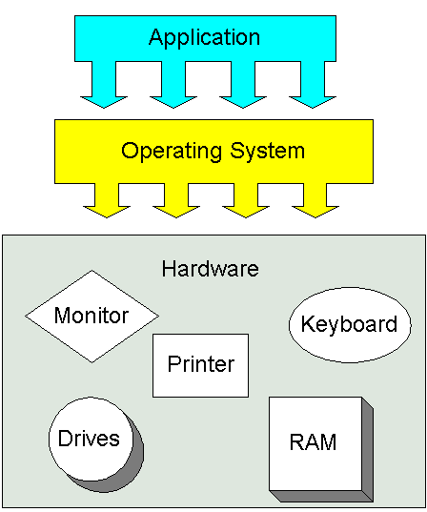

Introduction to OS
What is an Operating System?
An operating system (OS) is system software that manages computer hardware and software resources and provides common services for computer programs.

Slide 5
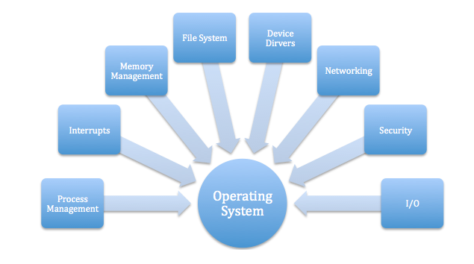
Why we need operating system

Slide 6
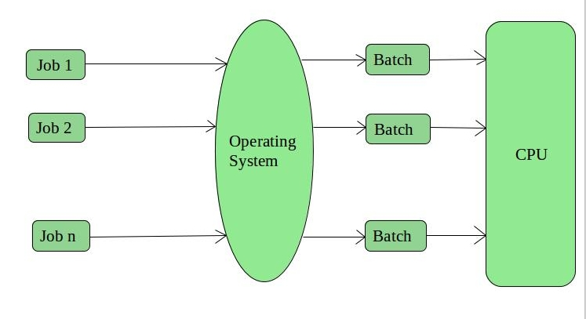
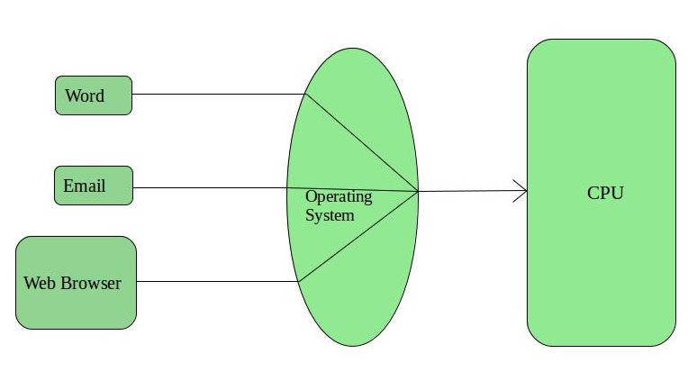
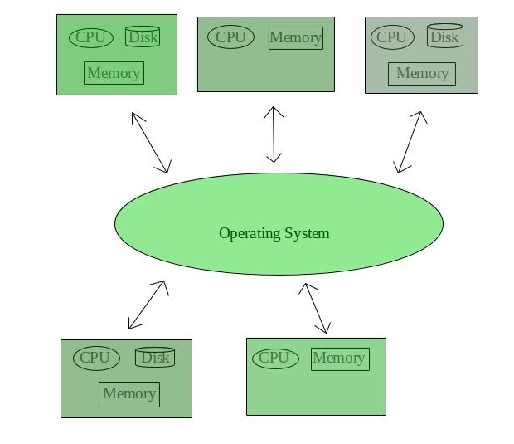
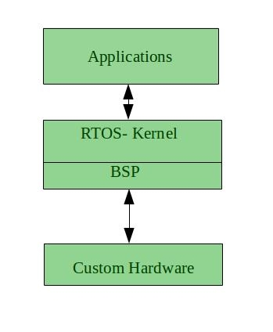
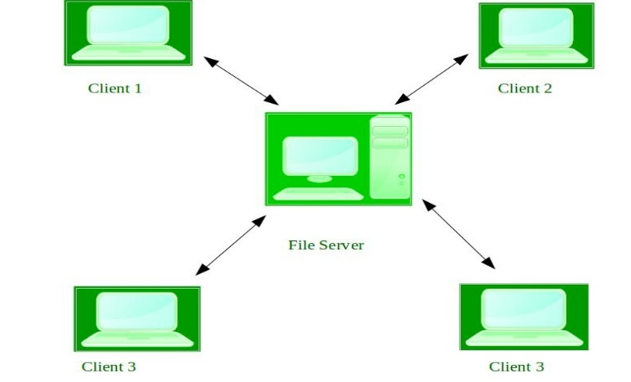
Types of Operating Systems
1. Batch Operating System
2. Time-Sharing Operating Systems
5. Real-Time Operating System
3. Distributed Operating System
4. Network Operating System

Slide 7
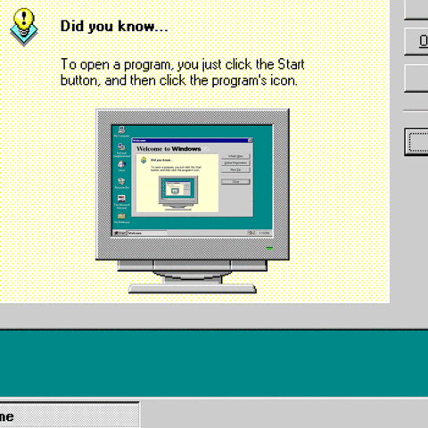
What is Windows OS?
Developed by Microsoft.
Each version of Windows includes a graphical user interface, with a desktop that allows users to view files and folders in windows.
Designed for both home computing and professional purposes.

Slide 8
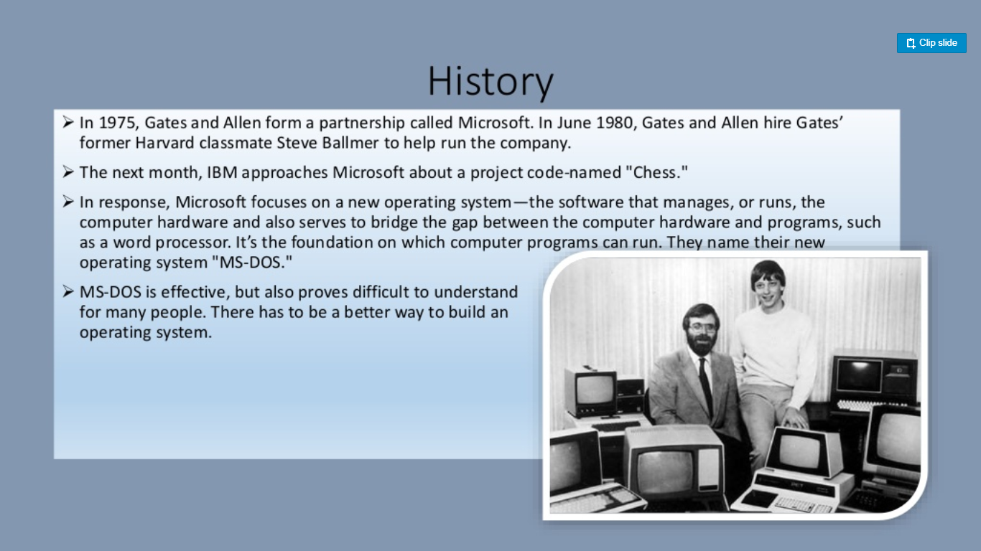

Slide 9

Pros and Cons of Windows OS
Not strong enough for high security.
Are buggy.
Windows series are big.
Windows ME and earlier 9x versions are unstable and insecure.
Source codes of Windows are closed, owned by Microsoft
Wide spread.
Not very expensive.
Supported by most popular softwares.
Windows NT series after 2004 are stabler and securer.

Slide 10
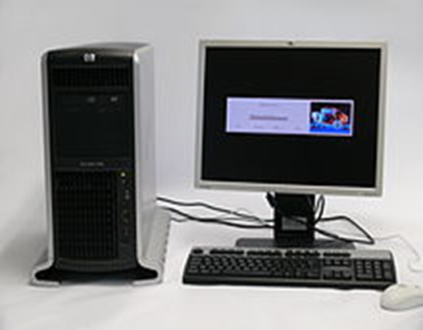
WORKSTATION SERVER
A workstation is a special computer designed for technical or scientific applications.
Intended primarily to be used by one person at a time, they are commonly connected to a local area network and run multi-user operating systems.
Workstations offers higher performance than mainstream personal computers, especially with respect to CPU and graphics, memory capacity,
and multitasking capability.

Slide 11

What is windows server OS?
Microsoft Windows Server OS (operating system) is a series of enterprise-class server operating systems designed to share services with multiple users and provide extensive administrative control of data storage, applications and corporate networks.
Development for Windows Server started in the early 1980s
Microsoft engineer David Cutler developed the kernel of Windows NT with the intent to provide speed, security and reliability that large organizations require in a server operating system.

Slide 12
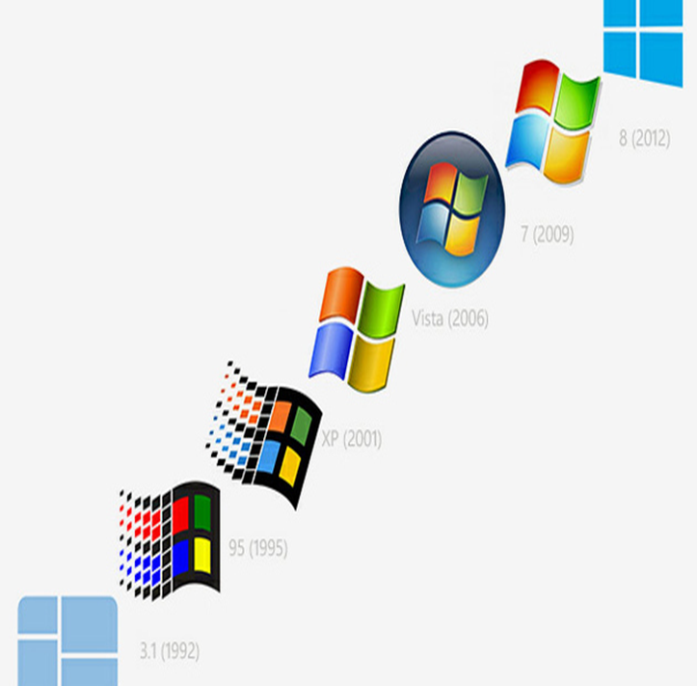
Versions of Workstation
Windows NT 3.1 1993
Windows NT 3.5 1994
Windows NT 3.51 1995
Windows NT 4.0 1996
Windows 2000 1999
Windows XP 2001
Windows Vista 2006
Windows 7 2009
Windows 8 2012
Windows 8.1 2013
Windows 10 2015

Slide 13
Features
Windows 7
Start menu
Taskbar and Notification area
Windows Snipping Tool
Displaying to a External Monitor or Projector
Using LAN
Windows explorer libraries
Windows server 2008 R2
Server Core.
Active Directory roles.
Failover Clustering.
Self-healing NTFS.
Hyper-V.
Windows System Resource Manager.
Server Manager.

Slide 14
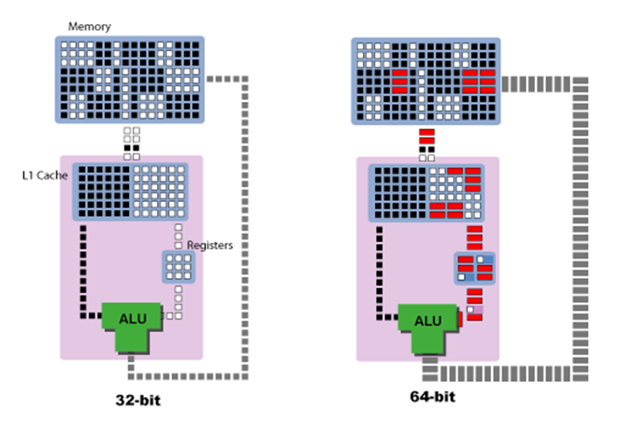
32-bit vs 64-bit
 | 32-bit | 64-bit
Memory storage | 4GB | 128gb
Addresses | 2^32 | 2^64
Speed | Slow | Fast
Compatibility | Not possible | Possible
Cost | Less | More
Examples | Windows 95, 98, NT, 2000, XP, Vista. | Windows 7,8,8.1, 10

Slide 15
Windows Kernel

Slide 16
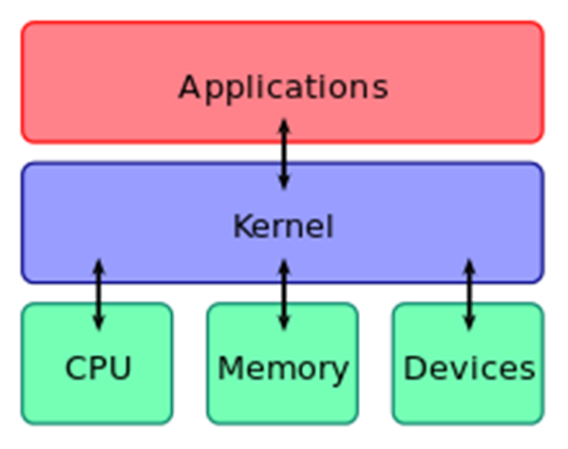
Kernel
It is a computer program, which have complete control over all other programs in the system.
Central module of operating system.
Connects the application software to the system hardware.

Slide 17
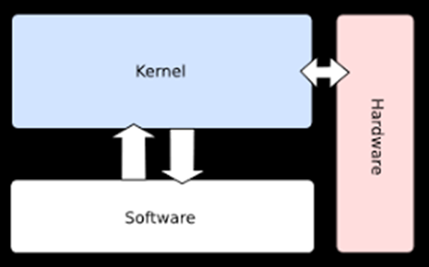
Monolithic Kernel
One single program that contains all of the code necessary to perform every kernel related task.
Deals with the system services like process management, device management, Interrupt handling, file system etc.,
Acts as an interface between the hardware and software.
Faster execution because no queue process.

Slide 18
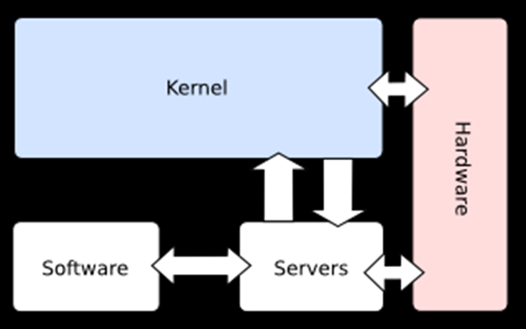
Micro Kernel
Deals with basic scheduler, basic memory handling, basic I/O primitives
The microkernel design allows for easier management of code due to its division into user space services.
This also allows for increased security and stability resulting from the reduced amount of code running in kernel mode.

Slide 19
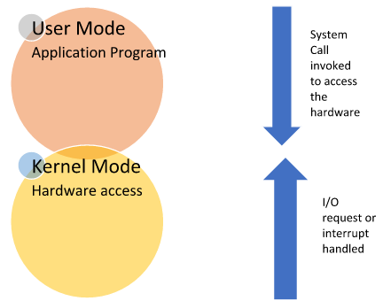
Modes of Kernel
User Mode
Kernel Mode

Slide 20
User Mode
Mode in which the computer application runs.
When the process is in user mode and requires any hardware resource, that request is sent to the kernel.
Limited access to hardware.
Also called as less privileged mode, slave mode or restricted mode.

Slide 21
Kernel mode
Also called as System mode or Privileged mode.
A kernel is a software program which is used to access hardware components of a computer system.
When the process is executing in user mode and if that process requires hardware resources such as RAM, printer etc, that process should send a request to the kernel.
Then the computer enters Kernel Mode from user mode.

Slide 22
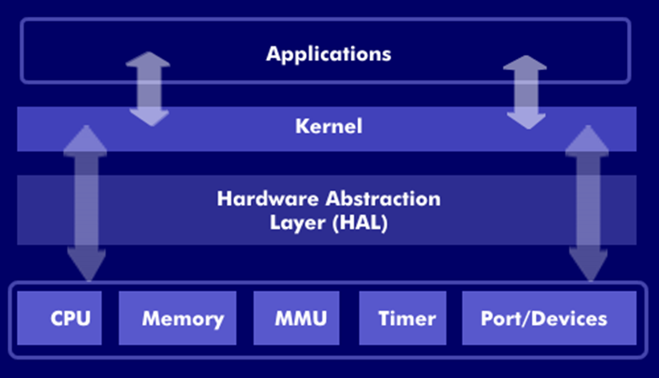
Kernel Components
1.HAL
2.Executive services
Hardware Abstraction layer
Isolates kernel from hardware variations.
It consists of a series of functions that hides or abstract the differences between hardware platforms.

Slide 23

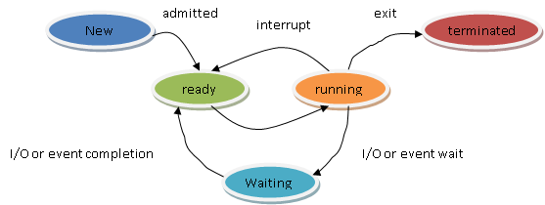
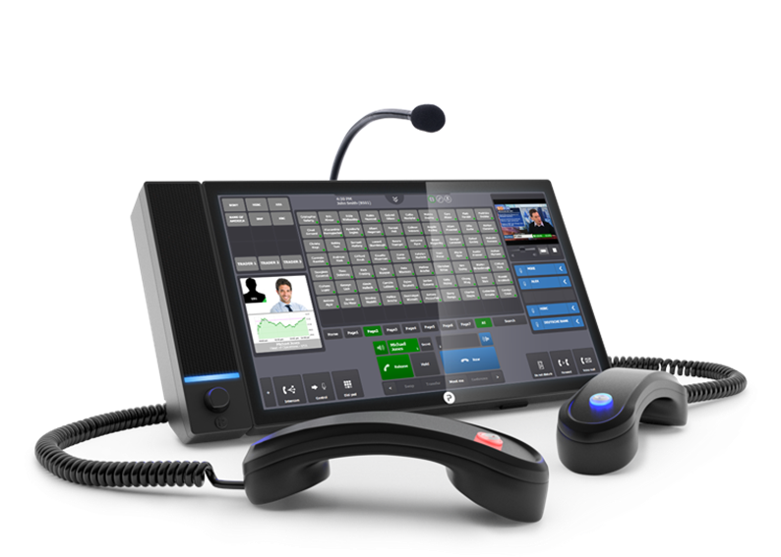


2. Executive Services
Security Reference Monitor
Process Control Block
Local Procedure Call
Plug and Play Manager
Configuration Manager

Slide 24
Booting Process

Slide 25
Windows Booting Process
BIOS Initialization
OS Loader
Kernel Initialization
Session Initialization
Winlogon Initialization
Explorer Initialization

Slide 26
1. BIOS Initialization
The BIOS, also known as the Basic Input Output System is a firmware or set of instructions that resides on a ROM chip as contained in the motherboard.
1. SMPS
2. Processor
3. BIOS – POST + Boot Priority
MBR (Ist Sector)
Boot Sector

Slide 27
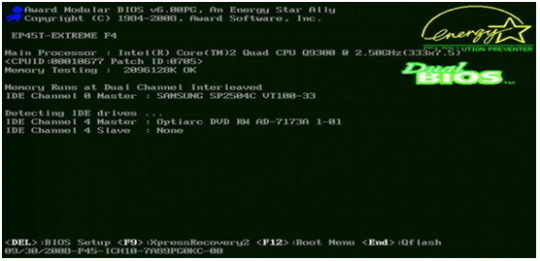
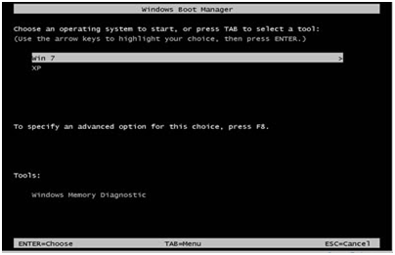
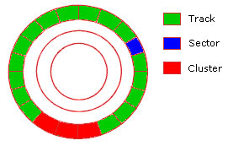

Slide 28
2. OS Loader
Boot Sector
Boot Manager
bootmgr
Boot Loader
winload.exe
winresume.exe
(Hibernation)

Slide 29
2. OS Loader
Boot Sector
Boot Manager
bootmgr
Boot Loader
winload.exe
Loads kernel
(Ntoskernel.exe)

Slide 30
*Kernel Processing in OS Loader stage
Loads kernel
(Ntoskernel.exe)
Load Boot Drivers – Load to Memory, Verify Signatures, Verify Certificates
Load Configuration data (Registry files)

Slide 31
3. Kernel Initialization
Boot Loader
winload.exe
Phase 0
Ntoskernel.exe
Phase 1
Initialize kernel (ntoskernel.exe)
Initialize hal.dll, bootvid.dll
Start the debugger
Initialize routines for executive services.

Slide 32
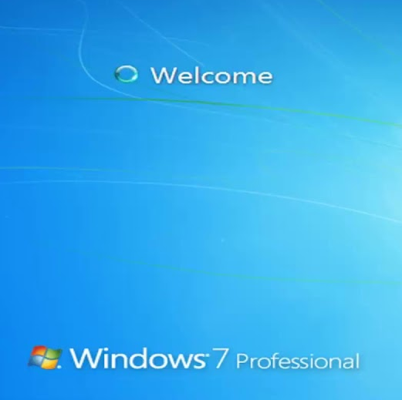
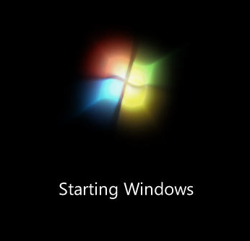
4. Session Initialization
Run boot execute (typically Autochk)
Open known DLLs
Create additional paging files
Initialize the registry HKLM\SAM, security, software
Create system ENV variables
Loads kernel mode part of windows subsystem (win32k.sys)
Initialize Client Server Runtime Subsytem
Session 0 Initialization Wininit.exe
Session 1 & beyond initialization Winlogon.exe

Slide 33
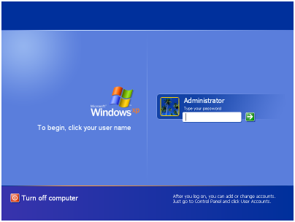
5. LOGON SEQUENCE
During the logon sequence, Winlogon.exe starts the Local Security Authority (LSA).

Slide 34
5. Explorer Initialization
Logon Interface LogonUI.exe
Loads registry HKCU
Desktop Window Manager Dwm.exe
Initiates user Userinit.exe
Loads Explorer.exe

Slide 35
FILE SYSTEM

Slide 36
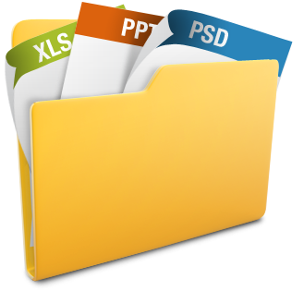
File
A file is a collection of related info defined by its creator.
In general, file is a sequence of bits, bytes, lines or records.
Some examples of file types :
Text file – sequence of characters organized into lines.
Source file – sequence of subroutines or functions.
Object file – collection of words, organized into loader record blocks.

Slide 37
File Parameters
JustForFun
123
Txt
1024 KB
Read-only
Used to keep track of file in OS.
Name – human readable form
Identifier – unique ID (gen. numers)
Type – file type
Location – pointer to a device & location of file on the device
Size – current size
Protection – Access control Info
Time & Date – Creation, modification,deletion
User ID – user identification

Slide 38
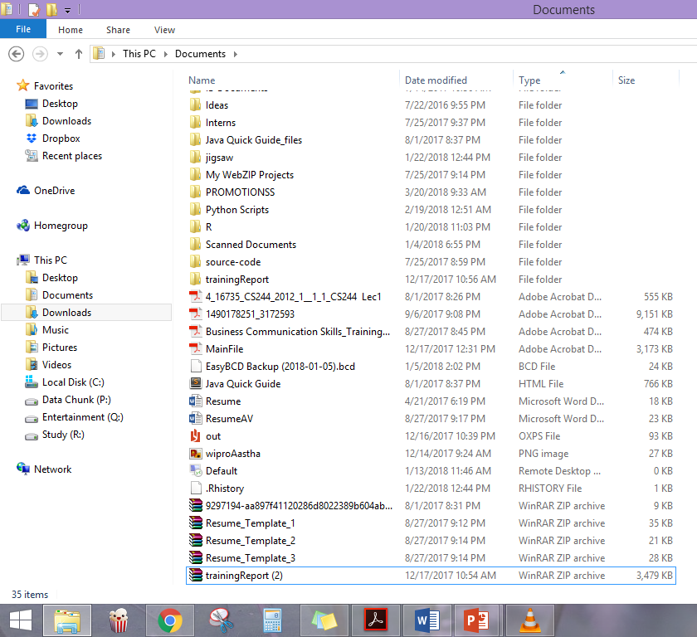
Files vs. Folders

Slide 39

FILE ATTRIBUTES
File attributes are settings associated with computer files that grant or deny certain rights to how a user or the operating system can access that file.
Read only
Hidden
System
Archive

Slide 40
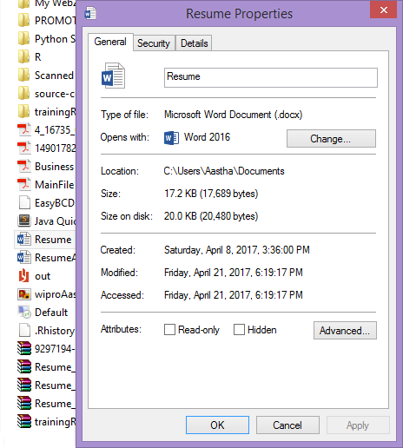
1. Read only (R)
Allows a file to be read, but nothing can be written to the file or changed.
When set, indicates that a file should not be altered. Upon opening the file, file system API usually does not grant write permission to the requesting application, unless the application explicitly requests it. Read-only attributes on folders are usually ignored, being used for another purpose.

Slide 41
2. Hidden (H)
File will not be shown when doing a regular dir from DOS.
When set, indicates that the hosting file is hidden. Windows apps like File Explorer do not show hidden files by default, unless asked to do so.

Slide 42

3. System (S)
System file.
When set, indicates that the hosting file is a critical system file that is necessary for the computer to operate properly.
Microsoft Windows use it to mark important system files.
Windows apps like File Explorer do not show system files by default even when hidden files are shown, unless asked to do so.

Slide 43
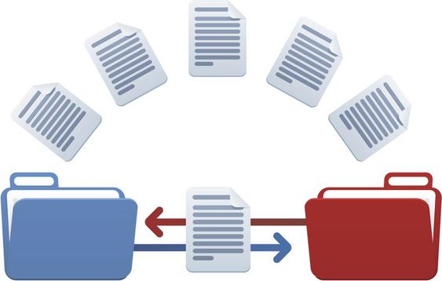
4. Archive File (A)
Tells Windows Backup to backup the file.
When set, it indicates that the hosting file has changed since the last backup operation. Windows' file system sets this attribute on any file that has changed. Backup software then has the duty of clearing it upon a successful backup.

Slide 44
More Attributes :
Compressed (C) – When set, Windows compresses the hosting file upon storage
Encrypted (E) – When set, Windows encrypts the hosting file upon storage to prevent unauthorized access.
Not Content-Indexed (I) – When set, Indexing Service or Windows Search do not include the hosting file in their indexing operation.
Directory (D) – The entry is a subdirectory, containing file and directory entries of its own.
Not Indexed (N) –The file is not indexed on the host device.
Offline (O) – The file data is physically moved to offline storage (Remote Storage).
Sparse (P) – The file is a sparse file, i.e., its contents are partially empty and non-contiguous.
Temporary (T) – The file is used for temporary storage.

Slide 45
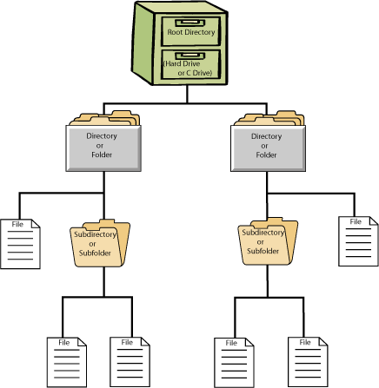
What is File system?
In computing, a file system controls how data is stored and retrieved.
The structure and logic rules used to manage the groups of information and their names is called a "file system".
Without a file system, information placed in a storage medium would be one large body of data with no way to tell where one piece of information stops and the next begins.

Slide 46
What is File system?
In other words, it’s a mechanism to organize our data.
It has its own data structure to achieve desired organization.
It has its own algorithm to achieve desired performance.
Its the ability to store, retrieve, sort, search,…….

Slide 47
Types of File System
Disk File System
Optical Disks
Flash File System
Tape File System
Database File System
Network File System
Shared Disk File System
Special File System

Slide 48
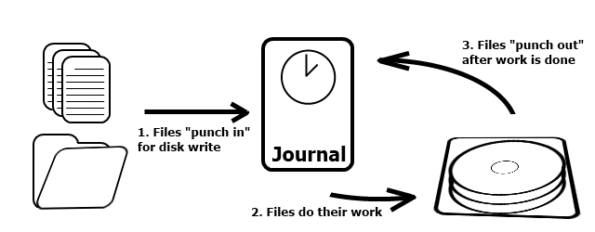
Disk File System
A disk file system takes advantages of the ability of disk storage media to randomly address data in a short amount of time.
Additional considerations include the speed of accessing data following that initially requested and the anticipation that the following data may also be requested.

Slide 49
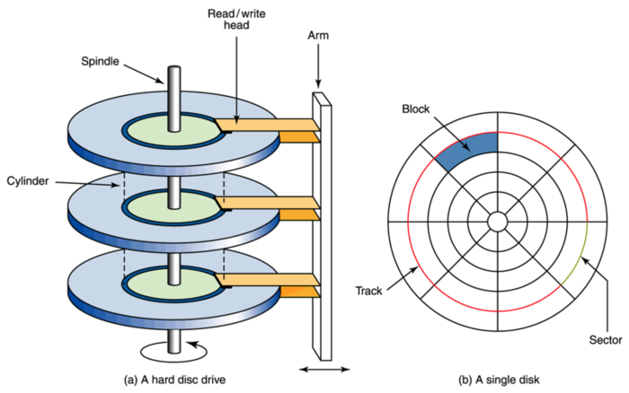
Disk File System

Slide 50
Disk File System
This system permits multiple users (or processes) access to various data on the disk without regard to the sequential location of the data.
Examples include :
FAT (FAT12, FAT16, FAT32), exFAT, NTFS, HFS and HFS+, HPFS, APFS, UFS, ext2, ext3, ext4, XFS, btrfs, ISO 9660, Files-11, Veritas File System, VMFS, ZFS, ReiserFS and UDF.

Slide 51
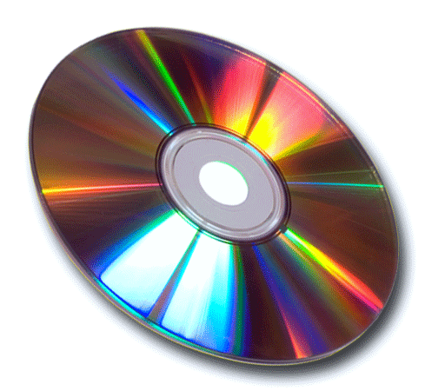
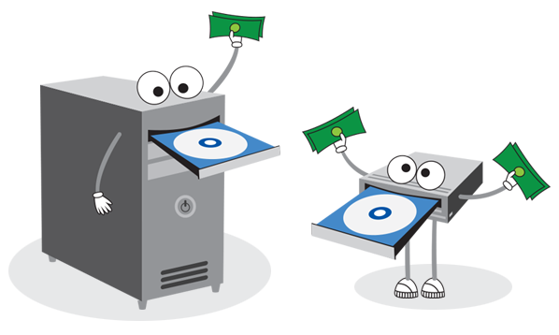
Optical Disks
ISO 9660 and Universal Disk Format (UDF) are two common formats that target Compact Discs, DVDs and Blu-ray discs.
Mount Rainier is an extension to UDF supported since 2.6 series of the Linux kernel and since Windows Vista that facilitates rewriting to DVDs.

Slide 52
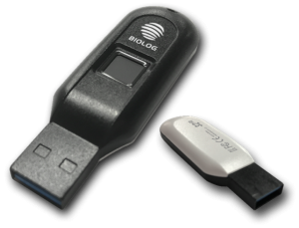
Flash File System
A flash file system is a file system designed for storing files on
flash memory–based storage devices.
While the flash file systems are closely related to file systems in general, they are optimized for the nature and characteristics of flash memory (such as to avoid write amplification), and for use in particular operating systems.
A flash file system considers the special abilities, performance and restrictions of flash memory devices.
Frequently a disk file system can use a flash memory device as the underlying storage media but it is much better to use a file system specifically designed for a flash device.

Slide 53


Tape File System
A tape file system is a file system and tape format designed to
store files on tape in a self-describing form.
Magnetic tapes are sequential storage media with significantly longer random data access times than disks, posing challenges to the creation and efficient management of a general-purpose file system.
Tape requires linear motion to wind and unwind potentially very long reels of media. This tape motion may take several seconds to several minutes to move the read/write head from one end of the tape to the other.
IBM has developed a file system for tape called the Linear Tape File System. The IBM implementation of this file system has been released as the open-source IBM Linear Tape File System — Single Drive Edition (LTFS-SDE) product.

Slide 54
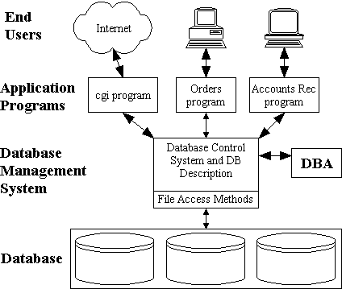
Database file systems
Another concept for file management is the idea of a database-based file system. Instead of, or in addition to, hierarchical structured management, files are identified by their characteristics, like type of file, topic, author, or similar rich metadata.
Around 1978 to 1988 Frank G. Soltis and his team at IBM Rochester have successfully designed and applied technologies like the database file system where others like Microsoft later failed to accomplish. These technologies are informally known as 'Fortress Rochester' and were in few basic aspects extended from early Mainframe technologies but in many ways more advanced from a technological perspective

Slide 55
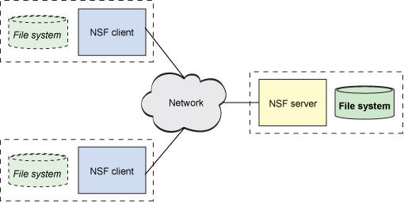
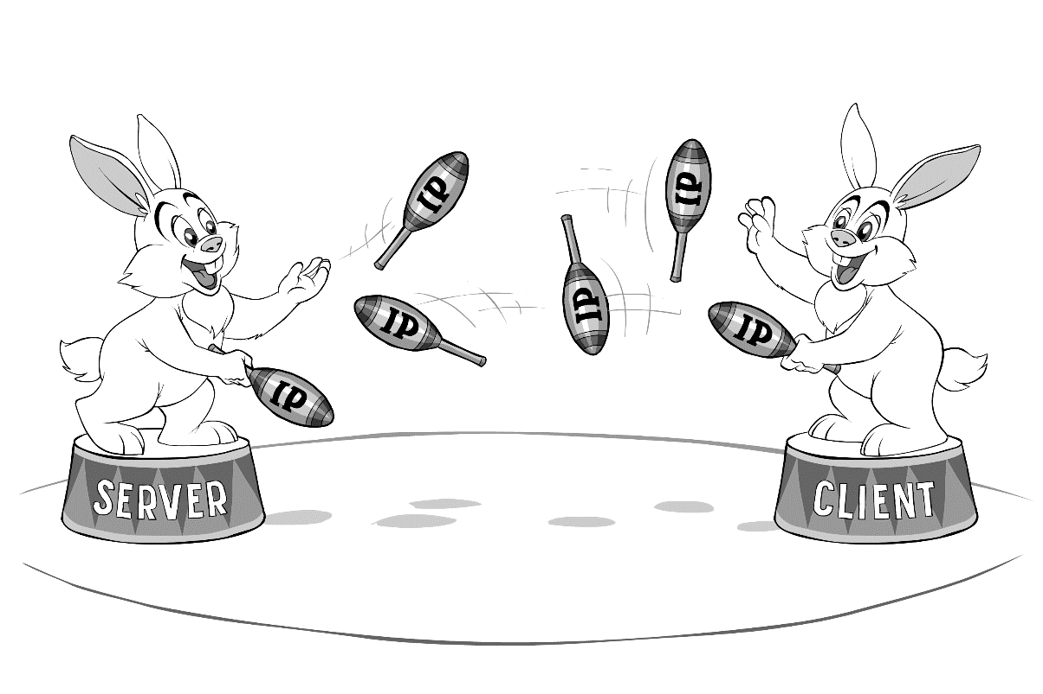
Network file systems
A network file system is a file system that acts as a client for a remote file access protocol, providing access to files on a server.
Programs using local interfaces can transparently create, manage and access hierarchical directories and files in remote network-connected computers.
Examples of network file systems include clients for the NFS, AFS, SMB protocols, and file-system-like clients for FTP and WebDAV.

Slide 56
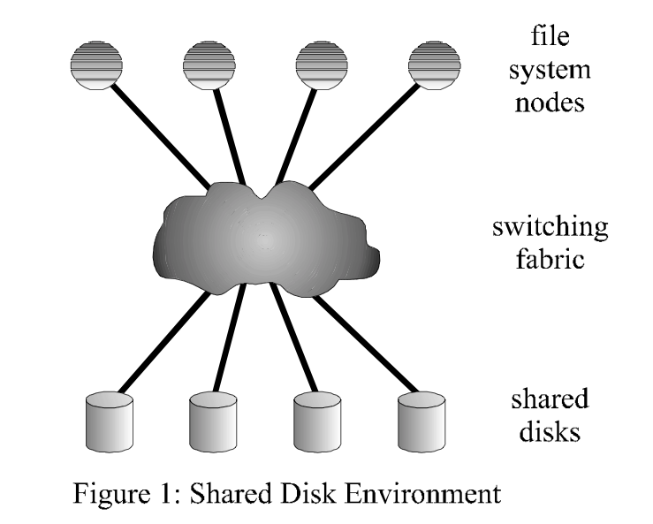
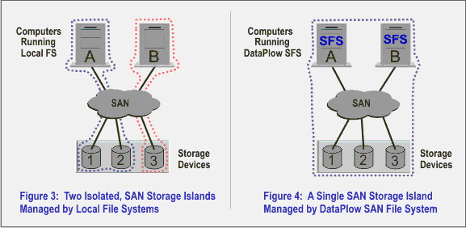
Shared disk file systems
A shared disk file system is one in which a number of machines (usually servers) all have access to the same external disk subsystem (usually a SAN). The file system arbitrates access to that subsystem, preventing write collisions.
Examples include GFS2from Red Hat, GPFS from IBM, SFS from DataPlow, CXFS from SGI and StorNext from Quantum Corporation.

Slide 57

Special file systems
A special file system presents non-file elements of an operating system as files so they can be acted on using file system APIs.
This is most commonly done in Unix-like operating systems, but devices are given file names in some non-Unix-like operating systems as well.

Slide 58
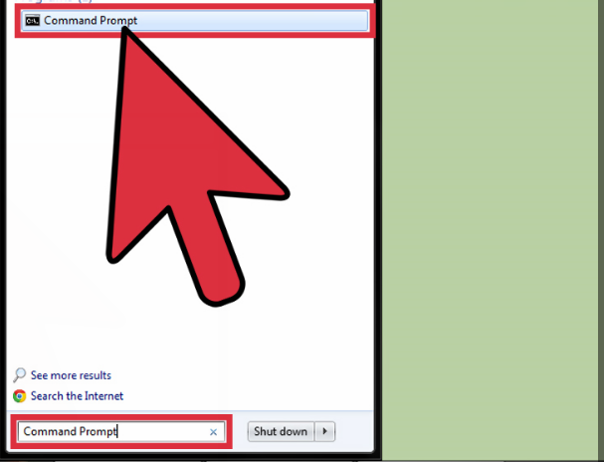
Creating files and directories
Using cmd prompt >>
1. Open the Windows Command Prompt :
Click on the start screen of your computer and go to the search box. Type command prompt or cmd. Double click on Command Prompt from the list of results to open the command prompt.
The command prompt will look like this c:\users\username

Slide 59
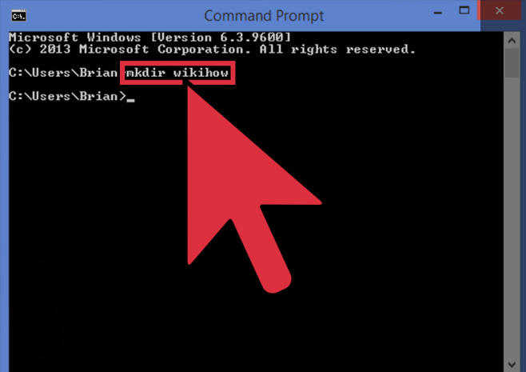
1. Creating directories
Use the mkdir command to create a new directory to work with.
The command is mkdir directory name.
In the example above, a new directory called wikihow was created by typing : mkdir wikihow.

Slide 60
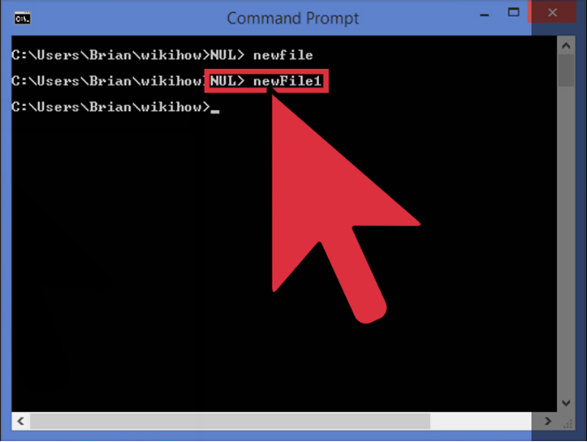
2. Creating files
In order to create a new file, use the type NUL > command.
Type: type NUL> filename and press enter to create a new empty file.
In the example above, type NUL> newFile1 was typed.

Slide 61
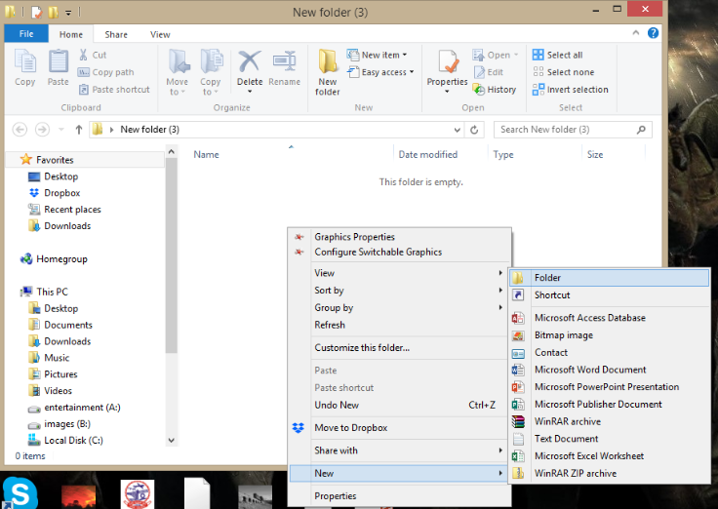
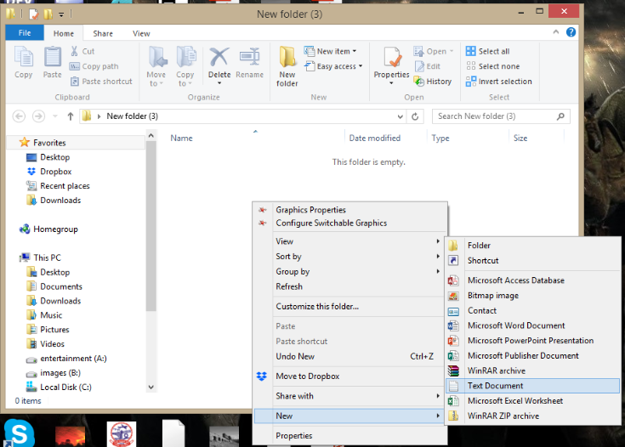
Creating files and directories (using GUI)
To make a directory -- right-click and select New Folder.
To make a file -- right-click and select
New Document -> Text Document.

Slide 62
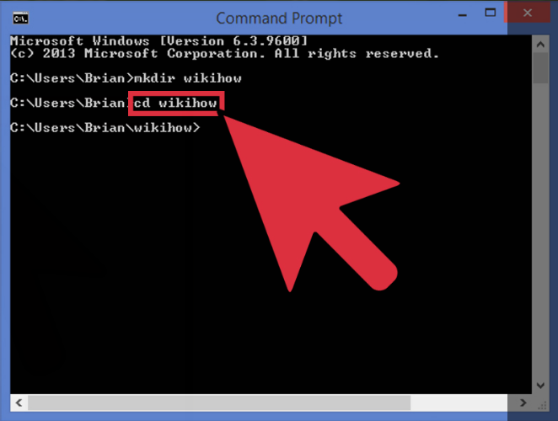
Opening Directories
Opening current working directory.
In order to move into the newly created directory, use the cd or change directory command.
The command is cd -> directory name.
In the example, cd wikihow was typed. Now the prompt looks like this: C:\users\Brian\wikihow>

Slide 63
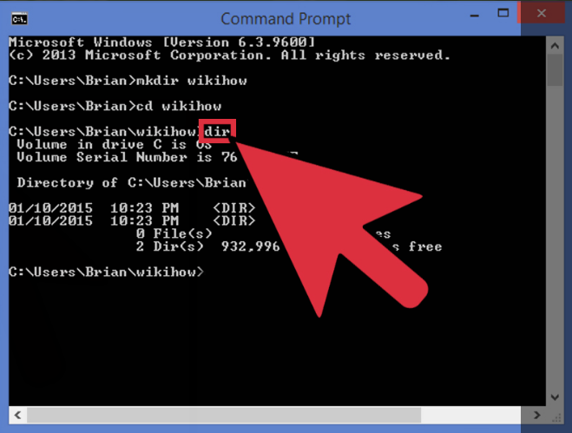
Reading Directories
Reading the directory contents.
In order to check the contents of the current directory, use the dir command.
Simply type dir and press enter and a list of the directory contents will be displayed as shown.

Slide 64

WINDOWS File System
In the early days of computing, Microsoft developed a file system, in collaboration with IBM ,which was named as FAT file system.
FAT file system was developed to meet the requirements of storage devices at that time, which used to be very limited in size.
Later on as the size of storage devices grew, FAT file system encountered many problems, so NTFS came into existence.

Slide 65

FAT (File Allocation Table)
FAT is by far the most simplistic of the file systems supported by Windows OS. The family of FAT file systems is supported by almost all operating systems for personal computers, including all versions of Windows and MS-DOS (FAT was used in MS-DOS and early versions of Windows such as 95 and 98).
The FAT file system is characterized by the file allocation table (FAT), which is really a table of content that resides at the very "top" of the volume.
To protect the volume, two copies of the FAT are kept in case one becomes damaged. In addition, the FAT tables and the root directory must be stored in a fixed location so that the system's boot files can be correctly located.

Slide 66
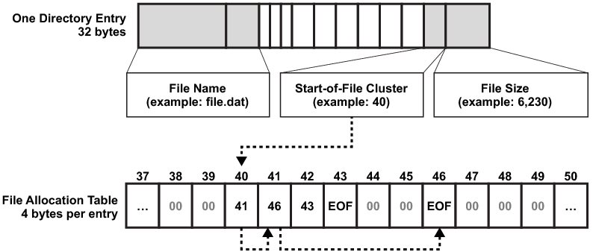
FAT (File Allocation Table)
A disk formatted with FAT is allocated in clusters, whose size are determined by the size of the volume. When a file is created, an entry is created in the directory and the first cluster number containing data is established. This entry in the FAT table either indicates that this is the last cluster of the file, or points to the next cluster.
FAT stores information about all files on the disk.
Uses linked-list as its data structure.

Slide 67
FAT Naming Conventions
FAT uses the traditional 8.3 file naming convention and all filenames must be created with the ASCII character set.
The name of a file or directory can be up to eight characters long, then a period (.) separator, and up to a three character extension. The name must start with either a letter or number and can contain any characters except the ones mentioned alongside >>>>>
The name cannot contain any spaces
All characters will be converted to uppercase.
.
“
/
\
[
]
:
;
|
=
,
The following names are reserved: CON, AUX, COM1, COM2, COM3, LPT1, LPT2, LPT3, PRN, NULL

Slide 68
FAT : Table Layout
BOOT SECTOR | FAT TABLE | ROOT DIRECTORY | DATA AREA
Boot sector:
located at the sector 0 of the disk.
It contains the information like, how many clusters are there in a track.
How many sectors are there on each cluster.
What is the size of each sector.
Root Directory: It is the Primary directory of the disk.
Data Area:
This is the place where actual data is stored on the disk.
It spans across the remaining sectors of the disk.

Slide 69
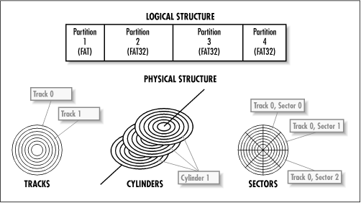
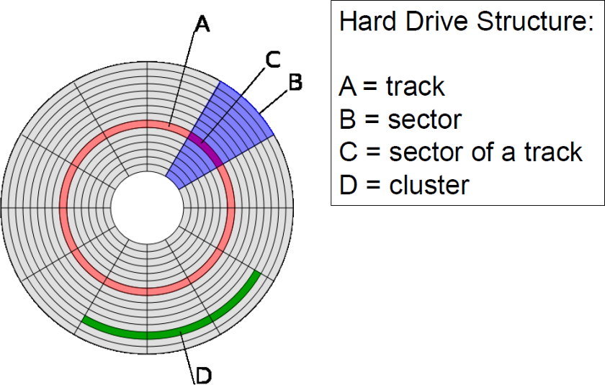
Sectors, Clusters and Volume ???????

Slide 70


FAT Table
It contains pointers to every cluster on the disk.
It indicates the no. of the next cluster on the disk
It indicates the end of a cluster.
Tells whether a particular cluster is empty or not.

Slide 71

FAT Versions
FAT12: The earliest version the file system, FAT12 allows a partition to contain up to 4096MB/ (212)clusters.
FAT 16: oldest, created for DOS, supported by most OS’s, cannot be installed on partitions larger than 2 GB, or on hard drives larger than 4GB.
FAT 32: supports disks from 512MB to 2TB, compatible with Windows 98 and up
The FAT number refers to the
number of bits per table entry :
FAT12 -> 212 = 4M different clusters can
be addressed (used for floppy disks)
FAT16 -> 216 = 64M different clusters can be addressed (MS-DOS compatible)
FAT32 -> 228 = 256G different clusters (4 bits are reserved)

Slide 72

Problems in FAT
Updating the FAT table is very important as well as time consuming. If the FAT table is not regularly updated, it can lead to data loss.
It is time consuming because the disk read heads must be repositioned to the drive's logical track zero each time the FAT table is updated.
There is no organization to the FAT directory structure, and files are given the first open location on the drive. In addition, FAT supports only read-only, hidden, system, and archive file attributes.

Slide 73

Problems in FAT
Fat file system was designed for disk of small size(up to few GBs), but later on the as the high capacity disks came into use, FAT file system could not support them.
FAT file system could not support the application required Recoverability, fault tolerance and file security.
Especially in corporate world, where recoverability and reliability was of great importance, FAT file system loose it ways to NTFS

Slide 74

NTFS - New Technology File System
Developed by Microsoft and was included in Windows like XP, Vista ,2007 and 2008.
NTFS supersedes FAT and has many technical improvements which was missing in FAT.
It uses advanced data structures like B+ trees.
It is more reliable as compared to FAT.
Includes features like security, compression encryption, journaling, Indexing.

Slide 75


How Does NTFS stores data on disk ?
In NTFS every sector is of 512 bytes. Each cluster consist of 2 sectors.
Size of each cluster =2*512Bytes 1024 Bytes or 1KB.’
Let the size of the file = 2000Bytes.
So NTFS will allocate 2 clusters(or 4 sectors).
First cluster will store= 1024 Bytes.
Second cluster will store =976 Bytes
The cluster need not to be contiguous

Slide 76
NTFS : Table Layout
PARTIONING BOOT SECTOR | MASTER FILE TABLE | SYSTEM FILES | FILE AREA
Partioning Boot sector:
Contains the information about volume.
Size of each sector.
No. of sectors in each cluster and size of each sector.
Contains details about boot startup.
File Area: (analogous to Data Area in FAT)
This is the place where actual data is stored on the disk.
It spans across the remaining sectors of the disk.

Slide 77

Master File Table
Its is like an Index
Stores Information about every file and table which is stored in the volume on a disk.
There is at least one record for every file and directory.
It stores the details like , type, size, date/time of the creation of the file, date/time about the recent modification and author identity.

Slide 78
Master File Table Layout
STANDARD INFORMATION | FILE NAME | SECURITY DESCRIPTOR | DATA | EXTENDED ATTRIBUTES
Standard Information : Include access attributes such as read only, read/write etc.
File Name : A file or a directory must have a name.
Security descriptor : Specifies who owns the file and who else can access it.
Data : The actual content of the file.
Extended attributes : Any additional attributes that the author wants to define.

Slide 79

System Files
Log file-Tells about transaction steps used for NTFS recoverability.
Cluster bit map-Shows which clusters are free or in use.
Attribute Definition-Tells about the attribute types supported on a volume.

Slide 80

Advantages of NTFS over FAT
1. RECOVERABILITY:
In case of system crash or disk failure, it has the ability to reconstruct its volume and bring it to the consistent state.
Recoverability comes from the fact, that it uses TRANSACTION processing model.
Each operation is considered as atomic, either it is entirely completed or not at all.

Slide 81
Advantages of NTFS over FAT
2. AVAILABILITY: NTFS system maintains multiple copies of the critical files, so in event of the failure of a portion of a disk, files can be accessed from other location.
3. JOURNALING: NTFS keeps a log of all changes made to files on the volumes .

Slide 82
Advantages of NTFS over FAT
4. SECURITY: NTFS is more secure as compared to FAT in the sense that there is a security descriptor attribute, that defines the access rights and prevents unauthorized access to the file.
5. COMPRESSION & ENCRYPTION: Entire directory or any Individual file can be compressed and encrypted transparently.

Slide 83



NTFS vs. FAT

Slide 84
 | NTFS | FAT
Security | It provides complete security to files and folders in the system. | There is no security of files and folders in the system.
Activity Log | In case of any failure, the files and folders can be easily restored. | In case of any failure, the files and folders are not recovered or restored.
File Compression | It supports flexible per file compression. | No such compression is supported.
File Size | It can be 4GB to 64 GB | It is 4GB Max
OS Compatibility | It only allows accessing on the recognized platforms, on a running computer. | It allows the accessing of files when the computer running on other or different platforms.
Data Sharing | It does not allow sharing data between the operating systems. | It allows sharing data between the operating systems.

Slide 85
OS and File System Compatibility
Operating System | FAT16 | FAT32 | NTFS
Windows XP | ✓ | ✓ | ✓
Windows 2000 | ✓ | ✓ | ✓
Windows NT | ✓ |  | ✓
Windows 98, ME | ✓ | ✓
Windows 95 | ✓
MS-DOS | ✓
Converting to NTFS :
In MS-DOS type command:
CONVERT drive: /FS:NTFS

Slide 86

Fat or Ntfs, But…………….
And Ntfs > Fat

Slide 87
Management Mechanism

Slide 88
The registry
Management Mechanism
Three fundamental mechanisms in Microsoft Windows that are critical to the management and configuration of the system
Services
Windows Management Instrumentation

Slide 89

REGISTRY
The registry is a hierarchical database.
Kernel, device drivers, services, Security Accounts Manager , and user interface can all use the registry.
Used to- Stores low-level settings for the Microsoft Windows operating system and for applications that opt to use the registry.
Example
When a program is installed, a new subkey containing settings such as a program's location, its version, and how to start the program, are all added to the Windows Registry.

Slide 90
STRUCTURE
Keys and values
Registry keys are container objects similar to folders. Registry values are non-container objects similar to files.
Hives
Branches of the registry are actually stored in a number of disk files called hives

Slide 91
EDITING
Registry editors
.REG files
Registry Editor allows users to perform the following functions:
Creating, manipulating, renaming^{[17]} and deleting registry keys, subkeys, values and value data
Importing and exporting .REG files, exporting data in the binary hive format
Loading, manipulating and unloading registry hive format files (Windows NT systems only)
Setting permissions based on ACLs (Windows NT systems only)
Bookmarking user-selected registry keys as Favorites
Finding particular strings in key names, value names and value data
Remotely editing the registry on another networked computer
Command line editing
PowerShell commands and scripts
COM self-registration
Programs or scripts
Offline editing

Slide 92
The Services Console allows you to:
The Services Console "service.msc" in the Control Panel.
List all program services.
View detailed properties of a service.
Change the startup type of a service to: Disabled, Manual, or Automatic.
Start or stop a service.

Slide 93
Examples of Windows Services
Active Directory Service
Computer Browser Service
Prefetch and Superfetch Service
Internet Connection Sharing (ICS) Service
Background Intelligent Transfer Service
DNS Client Service
Routing and Remote Access Service

Slide 94


Service Controller
Helps you take some load off the system when the OS initializes.
Minimizes the process involved while controlling Windows Services.
The program lets you manage (start, stop, restart) them in single click.
When asked to browse, select the service you would like to manage via Service Controller.
A list of the Windows Services will be shown.

Slide 95
SERVICE CONTROL MANAGER
Its main function is to start all the required services at system startup.
At boot time, SCM is launched by Wininit. Microsoft provides an API that allows developers to write their own Windows services and have them launched by SCM.
The service functions provide an interface for the following tasks performed by the SCM: * Maintaining the database of installed services. * Starting services and driver services either upon system startup or upon demand * Enumerating installed services and driver services. * Maintaining status information for running services and driver services. * Transmitting control requests to running services. * Locking and unlocking the service database.

Slide 96
Device Management

Slide 97

What is Device Management?
The process of managing the implementation, operation and maintenance of a physical and/or virtual device.
Includes various administrative tools and processes for the maintenance.
Device management performs:
Installing device and component-level drivers
Configuring a device so it performs as expected
Implementing security measures and processes.

Slide 98


Device Management

Slide 99

What is Device Driver?
Program that controls a particular type of device that is attached to the computer.
Device drivers for printers, displays, CD-ROM readers, diskette drives, and so on.
It converts the I/O instructions of the OS to messages that the device type can understand.

Slide 100

Device Controller
A device controller is a part of a computer system that makes sense of the signals going to, and coming from the CPU.
The Device Controller works like an interface between a device and a device driver.
Device controller is a hardware whereas device driver is a software.

Slide 101
POWER STATES
6 States
1.Working
2.Modern stand-by
3.Sleeping
4.Hibernate
5.Soft-off
6.Mechanical-off

Slide 102
Process Management

Slide 103

PROCESS MANAGEMENT
PROCESSES
An application consists of one or more processes.
A process in the simplest terms is an executing program.
THREADS
A thread is the basic unit to which the operating
system allocates processor time.
A thread can execute any part of the process code,
including parts currently being executed by another thread.

Slide 104

PROCESS STATES
Processes can be in any one of the following states:

Slide 105


PROCESSING TYPES
MULTIPROCESSING

Slide 106


2. MULTITASKING

Slide 107


3. MULTITHREADING

Slide 108

4. HYPERTHREADING

Slide 109
Memory Management

Slide 110
Virtual Address Space and Physical storage
The virtual address space for a process is the set of virtual memory addresses that it can use.
The address space for each process is private and cannot be accessed by other processes unless it is shared.
It can be smaller or larger than the total physical memory available on the computer.
Physical storage and the virtual address space of each process are organized into pages, units of memory, whose size depends on the host computer.
Notes:
Fixar a posicao do titulo – sempre do lado esquerdo.
Sempre que tiver muito texto o coluna deve sempre ser “ narrowed” , se nao fica dificil de ler. Colocar paragrafos no texto.
Linha vertical deve ser mais fina e as pontas NUNCA devem ser arredondadas.

Slide 111
Working Set
It is the set of pages in the virtual address space of the process that are currently resident in physical memory.
It contains only pageable memory allocations
Page State
The pages of a process's can be in one of the following states :
Free
Reserved
Committed
Notes:
Fixar a posicao do titulo – sempre do lado esquerdo.
Sempre que tiver muito texto o coluna deve sempre ser “ narrowed” , se nao fica dificil de ler. Colocar paragrafos no texto.
Linha vertical deve ser mais fina e as pontas NUNCA devem ser arredondadas.

Slide 112
Data Execution Prevention
It enables the system to mark one or more pages of memory as non-executable.
It prevents code from being run from data pages such as the default heap, stacks, and memory pools.
Memory Protection
Memory that belongs to a process is implicitly protected by its private virtual address space.
Copy-on-Write Protection.
Notes:
Fixar a posicao do titulo – sempre do lado esquerdo.
Sempre que tiver muito texto o coluna deve sempre ser “ narrowed” , se nao fica dificil de ler. Colocar paragrafos no texto.
Linha vertical deve ser mais fina e as pontas NUNCA devem ser arredondadas.

Slide 113
Paging
Paging is a memory management scheme that eliminates the need for contiguous allocation of physical memory.
The paging is done by the management unit (MMU).
The Physical Address Space is conceptually divided into a number of fixed-size blocks called frames.
The Logical address Space is also splited into fixed-size blocks, called pages.
Page Size = Frame Size

Slide 114

Paging Example
Physical Address = 12 bits, then Physical Address Space = 4 K words
Logical Address = 13 bits, then Logical Address Space = 8 K words
Page size = frame size = 1 K words (assumption)

Slide 115
Types of Paging
Demand Paging
Loader Paging
Anticipatory Paging
Swap Prefetch

Slide 116
Thrashing
The processor spends most of its time, swapping pieces rather than executing user instructions.
Disadvantages of thrashing :
Increases the degree of multiprogramming.
System throughput decreases.
Page fault rate increases.
Notes:
Fixar a posicao do titulo – sempre do lado esquerdo.
Sempre que tiver muito texto o coluna deve sempre ser “ narrowed” , se nao fica dificil de ler. Colocar paragrafos no texto.
Linha vertical deve ser mais fina e as pontas NUNCA devem ser arredondadas.

Slide 117
Fragmentation
Fragmentation is the inability to reuse memory that is free.
Types of fragmentation: internal and external fragmentation.
Causes of Fragmentation :
Isolated death
Time varying program behavior.
Notes:
Fixar a posicao do titulo – sempre do lado esquerdo.
Sempre que tiver muito texto o coluna deve sempre ser “ narrowed” , se nao fica dificil de ler. Colocar paragrafos no texto.
Linha vertical deve ser mais fina e as pontas NUNCA devem ser arredondadas.

Slide 118
Memory Pool
Memory pools are fixed-size blocks of memory that are thread-safe.
They operate much faster than the dynamically allocated heap and do not suffer from fragmentation.
The advantage of this is it reuse existing memory block so that reduce the times of system call.
Notes:
Fixar a posicao do titulo – sempre do lado esquerdo.
Sempre que tiver muito texto o coluna deve sempre ser “ narrowed” , se nao fica dificil de ler. Colocar paragrafos no texto.
Linha vertical deve ser mais fina e as pontas NUNCA devem ser arredondadas.

Slide 119
Types of Memory Pool
PAGED POOL :
It is the region of virtual memory that can be paged in and out of the system.
Is accessible from any process context.
NONPAGED POOL :
Consists of ranges of virtual address that reside in physical memory all the time.
Can be accessed any time.
Notes:
Fixar a posicao do titulo – sempre do lado esquerdo.
Sempre que tiver muito texto o coluna deve sempre ser “ narrowed” , se nao fica dificil de ler. Colocar paragrafos no texto.
Linha vertical deve ser mais fina e as pontas NUNCA devem ser arredondadas.

Slide 120

Virtual Memory
Virtual memory is the alternate set of memory addresses.
When the program is actually executed, the virtual address are actually converted into real memory addresses.
Notes:
Fixar a posicao do titulo – sempre do lado esquerdo.
Sempre que tiver muito texto o coluna deve sempre ser “ narrowed” , se nao fica dificil de ler. Colocar paragrafos no texto.
Linha vertical deve ser mais fina e as pontas NUNCA devem ser arredondadas.

Slide 121
Functions of virtual memory
Make the computer to share memory efficiently.
Eliminate a restriction that a computer works in memory which is small and be limited.
Protect programs to interfere each other in each memory area.
Notes:
Fixar a posicao do titulo – sempre do lado esquerdo.
Sempre que tiver muito texto o coluna deve sempre ser “ narrowed” , se nao fica dificil de ler. Colocar paragrafos no texto.
Linha vertical deve ser mais fina e as pontas NUNCA devem ser arredondadas.

Slide 122


